Slide 1
Virtual Turing Tumble
4th year project - Luke Gall
Notes:
Hello my names Luke, and welcome to my presentation about my 4th year honours project. The Virtual Turing Tumble.

Slide 2
Introduction
Turing Tumble is a marble based game where users can create marble-powered mechanical computers to solve logical puzzles
A fun educational game designed to teach users the small logical building blocks of computers
Project goals
Create an accurate simulator that could be a replacement for the rather large and expensive physical version
Allow users to build their own configurations using a graphical interface
Allow users to play puzzles using the simulator
Program should be easily to use and understand
Users should be able to create their own Turing Tumble puzzles that others can play
Notes:
Turing Tumble is a marble based game where users build marble-powered mechanical computers to solve logical puzzles. The vertical board consists of various slots where different logical components are placed to direct red or blue marbles to the bottom, releasing the next coloured marble and storing the output pattern. The main aim of the game is to create a mechanical computer configuration to produce a specific output marble pattern
This project had 5 main goals
The first was to provide an accurate Turing Tumble simulator. This includes correctly simulating all mechanical computer configurations that are possible within the physical version.
The second goal was to allow users to create their own configurations within the program using a graphical interface that they can then simulate.
Puzzles are the main way to play Turing Tumble so being able to view a list of puzzles within the program to play through was seen as a highly desirable feature.
The program was designed to be easy to use and understand for the target audience of Computer Science students and school pupils that could use this simulator as a replacement for the physical version. The program was designed around users unfamiliar with the physical game.
In order to encourage greater reuse of the program, users should be able to make their own puzzles for others to play. Increasing the likelihood of users returning to the site

Slide 3
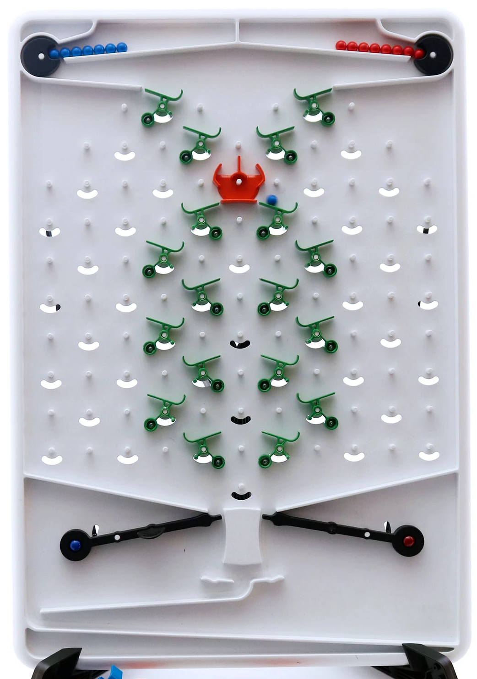
Turing Tumble
Marble dispensers top two corners
Marbles travel down the board interacting with different pieces which change the path it travels
At the bottom it is collected by the board and releases a new marble
Notes:
A picture can be seen here of a Turing Tumble board with pieces placed in slots.
Two marble dispensers are located in the top two corners of the board, one for blue and another for red, each dispenser can have multiple marbles of that colour. Each marble represents 'electricity' in the computer metaphor in the game. A marble travels down the board interacting with various components that change the direction the marble will travel. At the bottom of the board it will land on a blue or red flipper which will release another marble of that colour. The marble is also stored and displayed at the bottom. The main objective of the game is to place a combination of components to create a mechanical computer that will output a certain marble pattern.

Slide 4
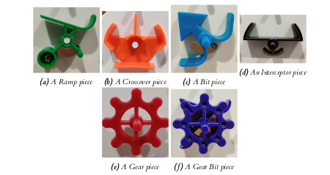
Turing Tumble Pieces
Ramp - directs marble left or right
Crossover - Keeps marble going in its current direction
Bit - send marble in opposite direction then change direction. Stores state
Interceptor - capture marble and stop execution
Gear and Gear Bit - acts as a bit but turns any connecting Gear Bits. Makes the game Turing Complete
Notes:
The game contains 6 different component types, with every piece being one of these types. A user places multiple pieces to create their configuration.
The Ramp sends a marble either right or left depending on the direction the curved end is facing. This piece can be reversed to change its direction.
The Crossover is a non reversible piece that continues the direction a marble is travelling into the piece and allows the marbles to enter from either side.
The Bit piece will change the direction the next marble will travel based on if it is 'on' (pointing to the right) or 'off' (pointing to the left). When a marble passes through a Bit it also changes the direction of this piece.
The Interceptor piece catches a marble and stops the execution as the marble will no longer be able to reach the end of the board and release another marble.
Gears can be placed to connect neighbouring Gear Bits together.
Gear Bits act like Bits unless connected to each other, in this case when it changes direction, it will also update any connected Gear Bits and also change their direction. This combination is claimed to make the board ‘Turing Complete’.

Slide 5
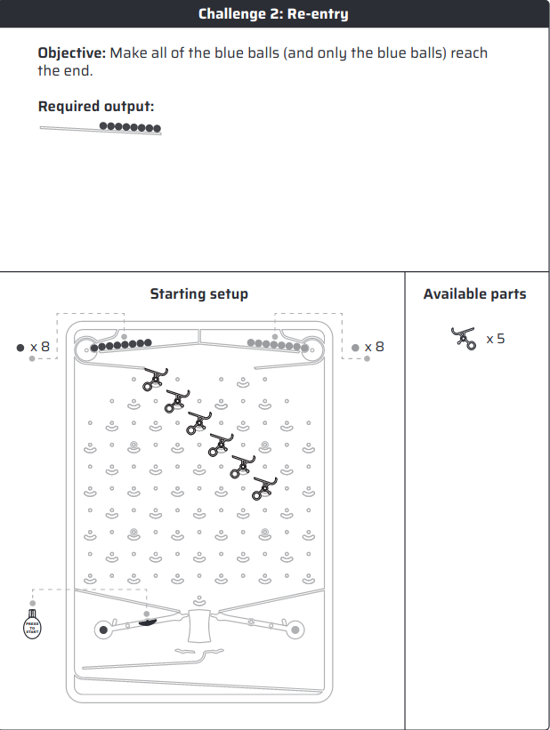
Turing Tumble Puzzles
Puzzles in Turing Tumble are the main way to play the game and give a clear objective with constraints to obtain a certain marble output
Users have a output they must aim to obtain
The board has a starting setup which users can’t change
They only have a certain number of pieces to complete the output, they start off simple but can get complicated quickly
Notes:
Puzzles are the main way to play Turing Tumble. An example puzzle from the Turing Tumble game guide is pictured.
A puzzle contains different attributes to describe the constraints and objectives including
A title.
Description - detailing the objective of the puzzle
The difficulty of the puzzle
The starting setup as shown, thsi includes the pieces that users can’t edit or change as part of the puzzle constraints
Avaliable parts - is the list of pieces uses can place to solve the puzzle
And finally the required output, the marble pattern that the board should output
This is the main way to play and learn using Turing Tumble, with a around 30 provided with the physical game

Slide 6
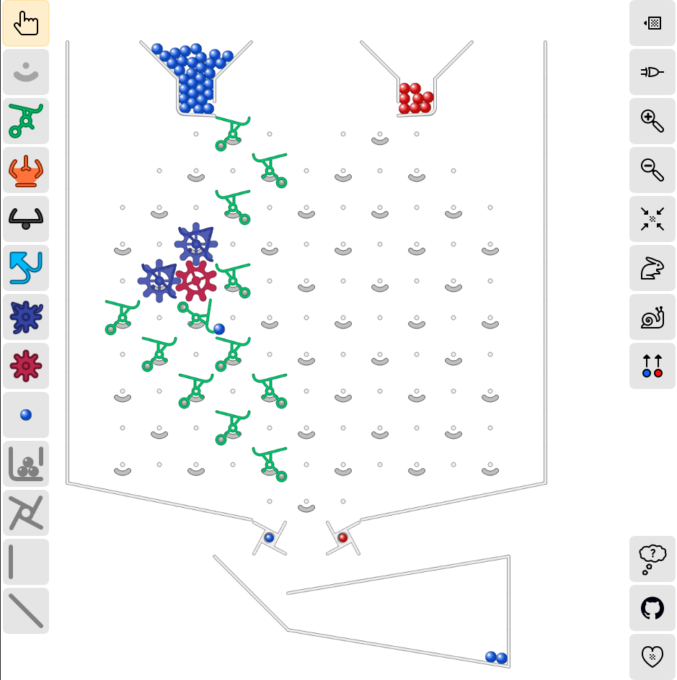
Existing Turing Tumble simulators
JSTumble - JavaScript emulator running online
Turing Tumble Simulator (Pictured) - Impressive online simulator with full gravity simulation
Emtumble - A desktop based simulator that allows users to make custom board layouts
All impressive but can’t play puzzles within the program
Notes:
Some existing Turing Tumble simulators were explored and analysed to gather requirements for the project. This included 2 web and 1 desktop application. They were all impressive and included some complex features, including custom board layouts or full gravity simulation.
However all of these simulators lack the ability for users to play through or create their own puzzles, meaning that most users would already need to be familiar with the physical game and just want to create their own configurations without any objectives to meet.

Slide 7
Requirements
The program requirements were split into if they would match functionality found in existing simulators or add new features to distinguish this program. Some example requirements include
Users should be able to make their own Turing Tumble configurations
Add playback features to the simulator
Allow users to play puzzles
Allow users to create their own puzzles
Allow users to filter puzzles based on difficulty
Notes:
The program requirements were split into if they would match functionality found in other simulators or add new features to help distinguish this program.
Some example requirements include
Allow users to place, delete and view pieces on a virtual Turing Tumble board
Add playback features to the simulator including speed controls and the ability to pause execution
Allow users to play puzzles, with a list provided from the official game guide
Allow users to create their own puzzles, which others can then access and play
Allow users to filter puzzles based on difficulty

Slide 8
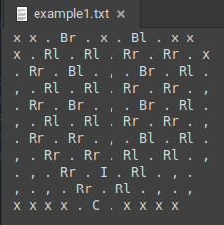
Design
Design decisions were explored before starting the implementation phase of the project including
Web application using the Angular framework
Created wireframes for various pages
Allow users to save board configurations as a txt file
Notes:
The program was designed as a web application. This allowed for a highly portable application that can easily accessible for the target audience of computer science students and school pupils.
Different wireframes were created following design decisions found in other simulators to aid external consistency, the design decisions ensuring the board was large and placed in the centre of the page with a non- intrusive selection bar to the left.
A board save feature was designed, where the various slots and pieces of the board would be converted to characters and follow the 11 by 11 board shape as pictured. Where Ramp is turned into a capital R and so on. This is then converted into a txt file as pictured which could be re uploaded to the site later.

Slide 9
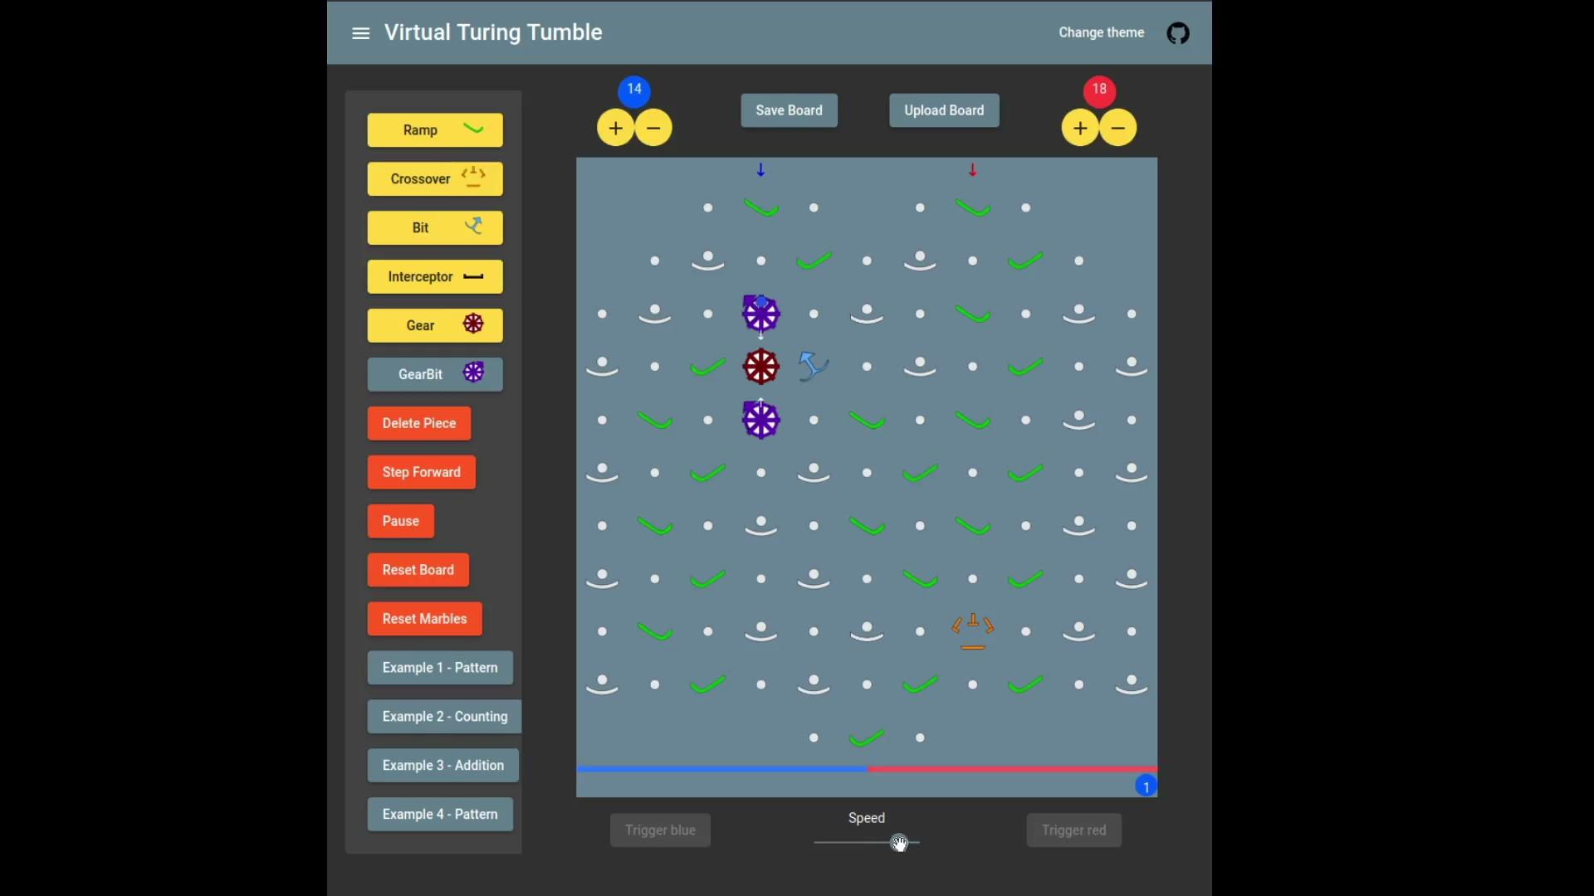
Implementation - Simulator Features
Users can create configurations by placing and deleting pieces
Users can simulate a Turing Tumble with marbles updating in real time
Playback and board options were added
Different example configurations can viewed to explore some more complicated Turing Tumble boards
Notes:
Users can create their own Turing Tumble configurations by using a side selection bar to hold different pieces to then place onto a Turing Tumble board. When a user hovers over a slot where a piece can be placed, a ‘ghost image’ is displayed to give an indication that this piece can be placed.
They can then simulate the marble travelling the down the board by selecting one of the triggers, the marble will then travel down and be displayed to the user in real time, with pieces updating when they interact with the marble.
Uses have access to different playback and simulator options including a speed slider, pausing execution, or resetting the current configuration.
Four example boards were made that users can open showing more complex configurations. The one shown here creates a 3,1,3 and so on pattern using Gear Bits and Bits.

Slide 10
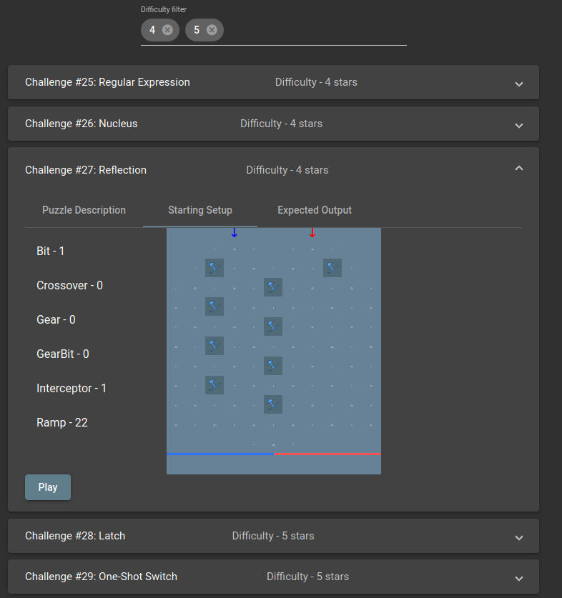
Implementation - Choosing Puzzles
Users can select from the puzzles found within the Turing Tumble game guide or user created puzzles
Users can filter the puzzles using a difficulty filter
Notes:
The picture shows the puzzle list page, the list of default puzzles available within the site. User created puzzles follow the same design but is accessed on another page. In this list every puzzle is given an individual card component which details the descriptive features needed to pick a puzzle, including its starting setup, objective and expected output.
A difficulty filter has also been implemented to allow users to filter the list by the difficulty of the puzzle, adding the puzzle difficulties they wish to view in the top filter bar at the top.

Slide 11
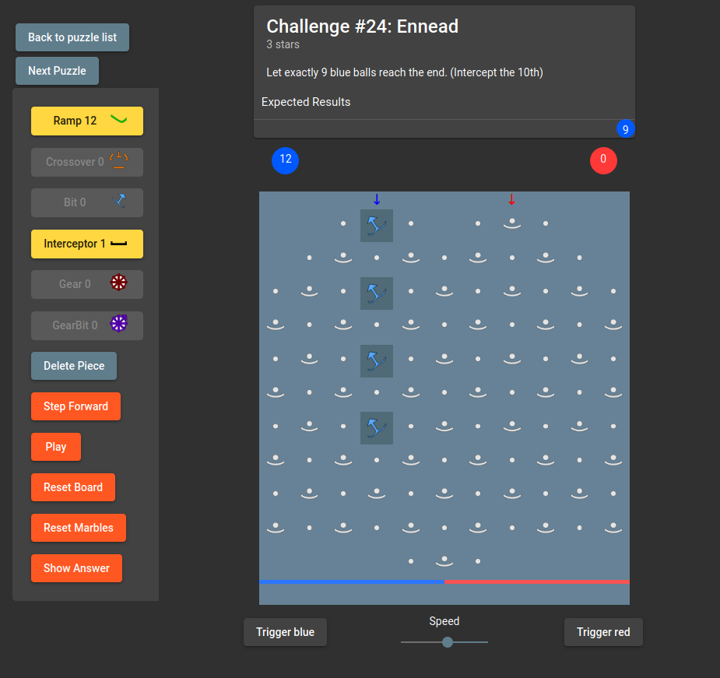
Implementation - playing puzzles
Users can play through puzzles as they would in the physical game
The rules present in Turing Tumble are enforced within the simulator
Users can also move to the next puzzle, while staying within their filtered list
Notes:
When playing a puzzle, a user is presented the same board layout as found in other areas of the site.
The starting setup of the puzzle is conveyed by the different background shade for the pieces. In this case the Bit pieces are locked, meaning users can’t edit these pieces, keeping with in the rules of Turing Tumble.
The number of pieces available to a user is shown on the selection bar to the left, where depleted pieces have their button disabled, meaning users can only use the pieces avaliable. The objective and expected output of the puzzle are shown at the top of the page as well.
Users can move onto the next puzzle without a page refresh, it will also stay within the list of puzzles they had possibly filtered.

Slide 12
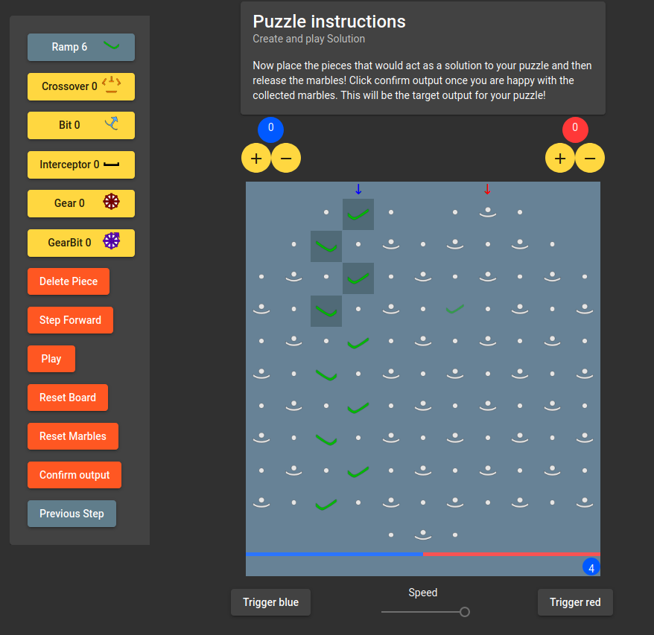
Implementation - Creating a puzzle
Users can create puzzles through a phase system that makes use of existing functionality
The user creates the starting setup for a puzzle
They then create the solution for the puzzle and play through it to get the required output
Finally they input the title, description, and difficulty through a simple form
Notes:
Users can create puzzles using using the board creation functionality found in other areas of the site i.e. piece placement and deletion. A user first creates the starting setup of the puzzle, locking in the pieces that will be locked.
A user will then make the solution to their puzzle and play through it in order to get their desired required output for the puzzle. This ensures puzzles can’t be uploaded without at least one person, the creator, being able to solve it. Other attributes of the puzzle, i.e. available pieces are captured when a user makes the solution to the puzzle and is not left as a form input, this ensures no incorrect puzzles can be uploaded.
Finally, users enter the title, description, and difficulty of their puzzle in a form before uploading it to the backend server

Slide 13
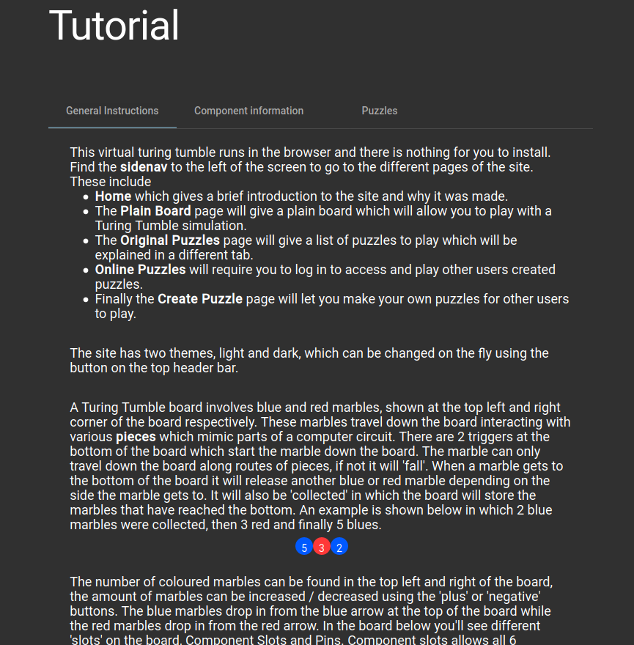
Implementation - Usability
A home page was created to give users a starting point for the site.
A detailed tutorial page was created to give details about using the program and playing Turing Tumble
Notes:
A home page was created to give users a starting point for the site, detailing the sites purpose and motivation to play Turing Tumble
The tutorial page was also made which includes three tabs of information. The first tab details how to use the site and play Turing Tumble. The second gives a table detailing information on all the piece types, including a gif on the piece in use. The final tab gives details on how to play and create Puzzles.

Slide 14
Evaluation
Two sets of use evaluation was carried out, monitored and unmonitored. Users were asked to follow a task sheet that focused on various features of the program then to rate the ease of use and give any suggestions for the program.
User feedback was positive with but one average response giving high ease of use
Different strong suggestions were given including an interactive tutorial, different filter types, and a clearer representation when multiple Gear Bits are connected.
Unit tests were created to test underlying logic of the program
Automated User Interface tests were created that tested various UI logic
Notes:
For evaluation, users were asked to carry tasks then fill out a evaluation sheet, asking them to rate ease of use and give any suggestions for various parts of the program.
Overall user feedback gave positive responses for ease of use, with suggestions given to improve any issues users found, including the suggestion of the ghost image or the ability to go back through steps when creating a puzzle.
Unit tests were made to ensure the logic of the simulator matched the logic found within the physical game. This includes testing Gear Bits change other connected Gear Bits and that the user cant delete the starting setup of a puzzle.
Some automated User Interface tests were also created for example checking the side navigation bar can be hidden by a user button press

Slide 15
Conclusion
Project created a Turing Tumble simulator
User evaluations were carried out to evaluate ease of use of the program
Different areas of future work include adding more features or polishing the existing implementation
Notes:
In conclusion, this project created software capable of simulating Turing Tumble and adding features to improve the learning possible through the game. After ensuring the program met most of the existing features found within the other simulators, puzzles and puzzle creation were added.
User evaluations found the program easy to use, while unit tests ensured the underlying logic matched that of the physical game.
Future work includes adding more features to match the other simulators, including full gravity simulation and custom board layouts. As well as more evaluation into the possible learning benefits that using a Turing Tumble simulator may have.

